Slide 1

WHAT DID WE LEARN THIS TIME?
Why design our apps?
Stages of app design
Benefits of app design

Slide 2
THIS SECTION’S BIG CHALLENGE!
Take all those resources you made from past lectures and put them all together in one place
Typed document
Notepad application
Online idea board
Notebook or scrapbook
For bonus points, get feed back from at least one person on your idea – ways you can do this are:
Share it with the rest of the group on our Slack board and swap ideas and critique each others plans
Or ask a family member or a friend
Post it on Twitter, Reddit, Facebook etc.

Slide 3
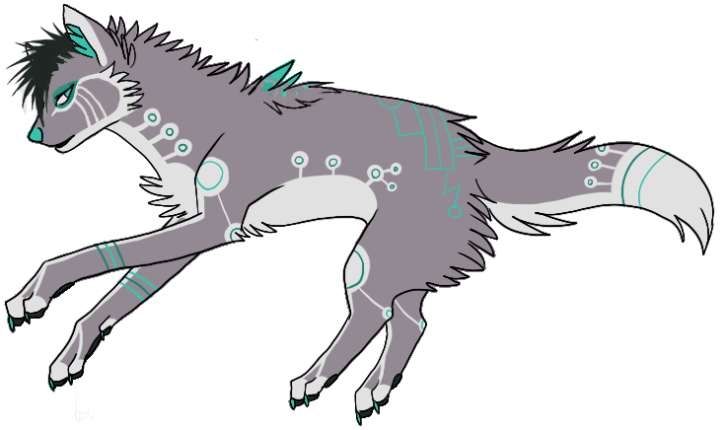
Need help?
Github:
http://www.github.com/webdevelopwolf/training
Twitter:
http://www.twitter.com/webdevelopwolf
Facebook:
http://www.facebook.com/webdevwolf

Slide 4

Next Section…
We’re going to be learning all about Ionic and the role it’s going to play in our project…

